Slide 1

Android Hackathon Project
APP: RAKSHINI
An app for the women

Slide 2
Team & Project Identity
Team Name
Rakshini
Team Lead Details
Team Member
Registration No.
Batch
Department
Year
Kuldeep Singh Shekhawat
22BCE10143
2
CSE
2026
Akshit Kumar
22BCE10406
2
CSE
2026
Jihirsh Singh
22BCE11267
2
CSE
2026
Dindayal Sinha
22BCE10707
2
CSE
2026
Siddharth Jha
22BCE10997
2
CSE
2026
Tanishq Kakkar
22BCE110682
2
CSE
2026

Slide 3
Contributions
Kuldeep Singh Shekhawat: Home Activity and UI
Responsibilities:
Develop and maintain Home page
Design and update activity_home.xml (including logout button, intro card, bottom navigation).
Ensure navigation between activities works (e.g., nav_sos, nav_period_tracker, nav_blogs).
Handle UI enhancements (e.g., top margin, navigation visibility).
Akshit Kumar: Login Activity and UI
Responsibilities:
Develop and maintain Login page.
Design activity_login.xml (e.g., username/password fields, login button).
Implement basic authentication logic (e.g., validate credentials, navigate to HomeActivity)
Jihirsh Singh: Period Tracker Activity and UI
Responsibilities:
Develop and maintain Period tracker page.
Design activity_period_tracker.xml (e.g., calendar, input for cycle data).
Implement basic period tracking logic (e.g., save dates, calculate cycle).

Slide 4
Dindayal Sinha: Blogs Activity and UI
Responsibilities:
Develop and maintain Blogs page.
Design and update activity_blogs.xml (e.g., scrollable cards with safety tips).
Ensure scrolling and card content are functional.
Siddharth Jha: SOS Activity and UI
Responsibilities:
Develop and maintain Sos page.
Design activity_sos.xml (e.g., emergency button, contact list).
Implement SOS functionality (e.g., send alert, call emergency number).
Tanishq Kakkar: Backend and Project Integration
Responsibilities:
Design and implement the backend (REST API).
Integrate backend with all activities (e.g., authentication, data sync).
Manage shared resources (e.g., colors.xml, strings.xml, drawables).
Coordinate builds and resolve conflicts.

Slide 5
Problem Overview
A clear understanding of the problem is crucial for developing an effective Android solution. This section outlines the key challenges your project addresses.
Problem Identification
User Impact
Women lack an integrated app for safety (e.g., emergencies) and health (e.g., period tracking).
Pain points include inaccessible SOS tools and fragmented health solutions.
Impacts daily safety and well-being, especially in crises.
Causes stress and inefficiency; affects millions of women globally.
Market Gap Analysis
Problem Validation
Existing apps focus on safety or health, not both, with outdated UIs.
Opportunity for a modern, unified solution with offline capabilities.
Validated via user interviews and market research.
Confirmed demand for a holistic, user-friendly women’s app.
Highlights a clear need for Rakshini to address safety and health gaps. Sets the stage for an innovative, user-centered solution.

Slide 6



Solution Overview
Core Innovation
Key Benefits
Technical Edge
Fills gaps with SOS, Period Tracker, and Blogs. Offers intuitive design with gradients and modern UI.
Provides easy navigation
(e.g., logout FAB). Enhances efficiency with persistent date logging.
Adds functionality via SOS and cycle predictions.
Uses ConstraintLayout and Material Design 3.
Employs Kotlin, Coroutines, and plans Room.
Follows Android best practices.
Our solution transforms the identified problem into an opportunity for innovation. We've focused on creating a user-centred experience that delivers real value.

Slide 7
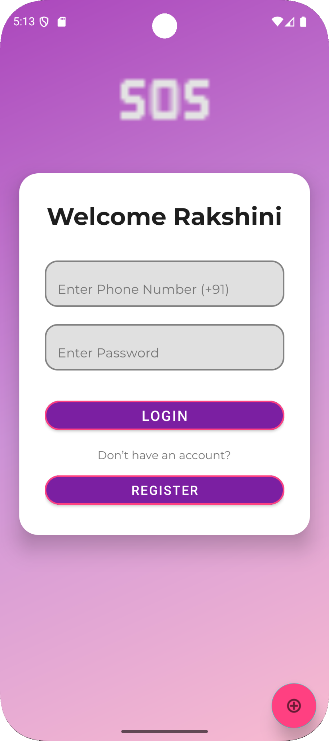
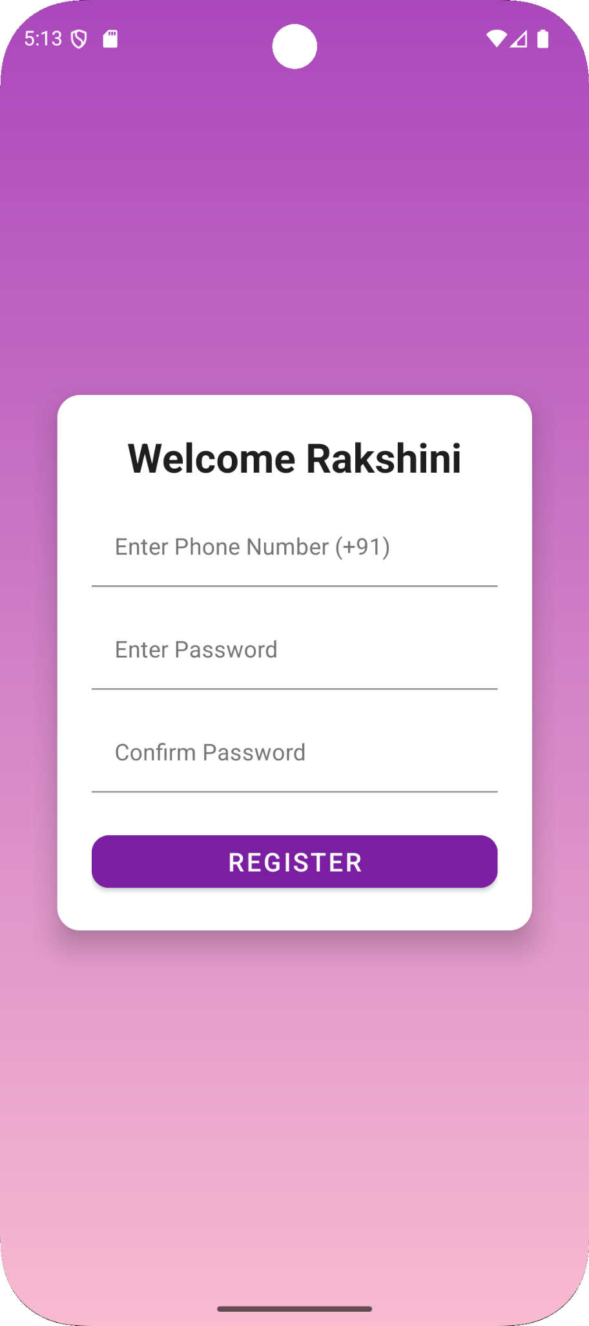
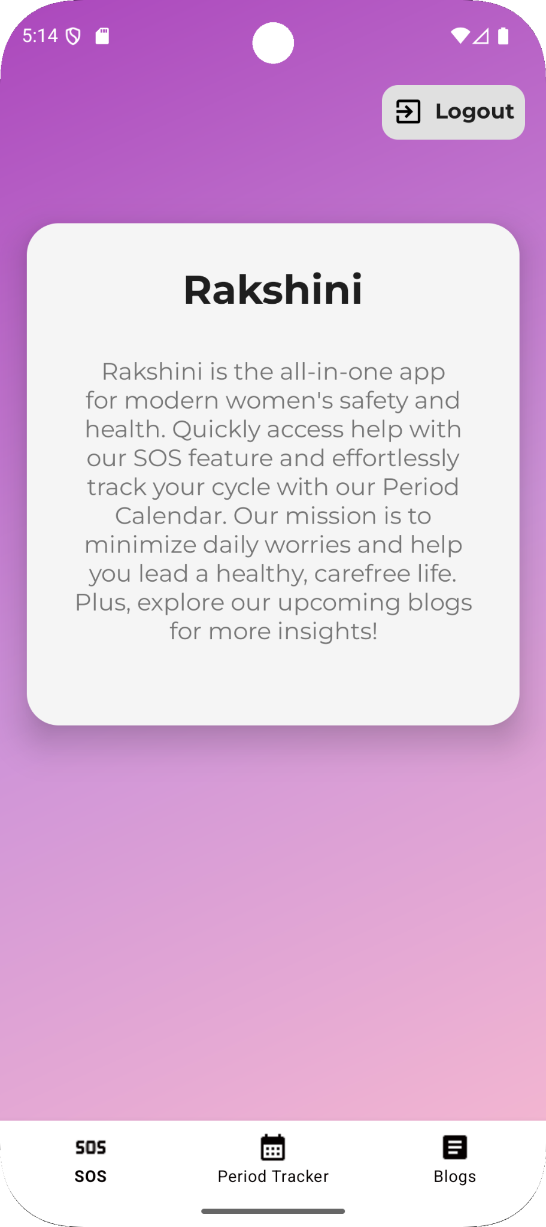
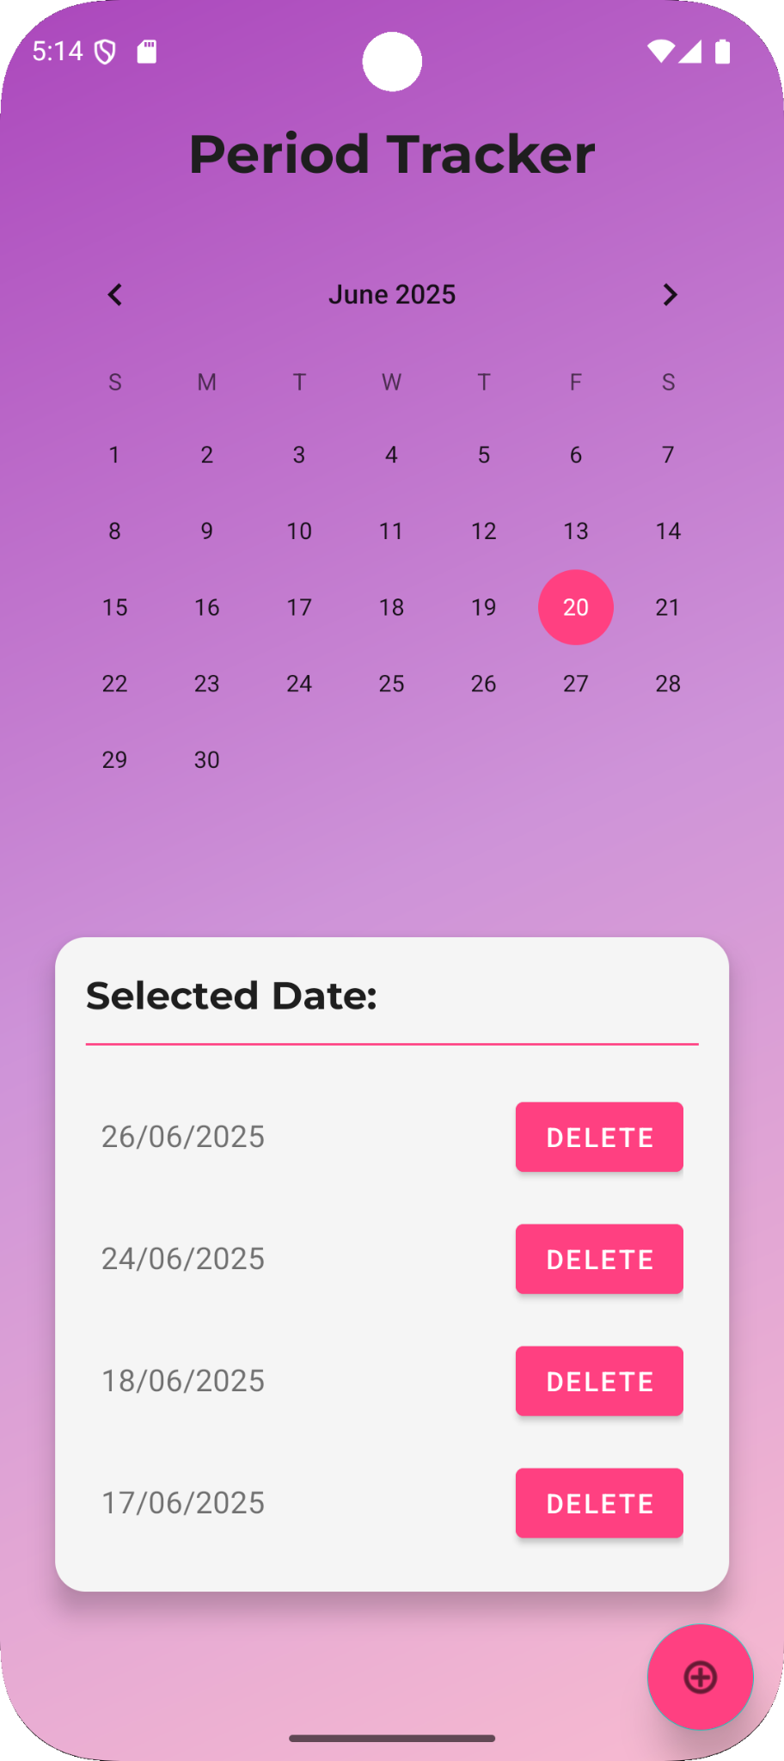
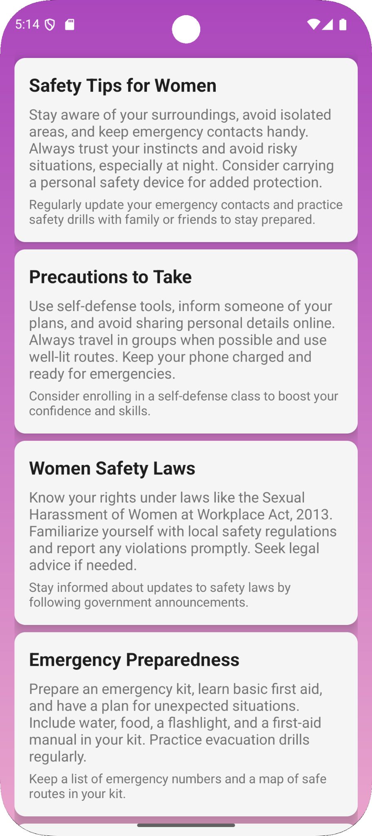
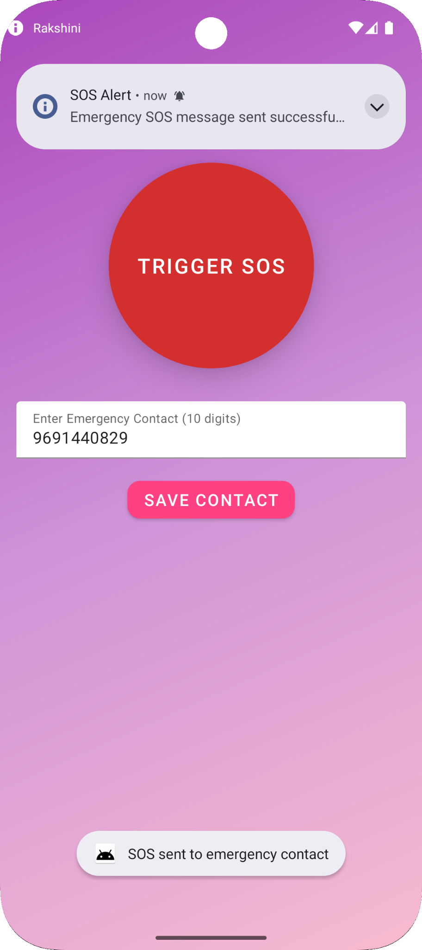
Screenshots
It features notifications to remind users of safety checks and period tracking updates. The SMS functionality allows sending emergency messages to predefined contacts. The SOS feature enables quick alerts with a single tap, potentially integrating location data. Period tracking offers a calendar to log cycles, predict dates, and provide health insights. Blogs provide educational content on safety, self-defense, and wellness. The register module allows users to sign up with secure authentication, linking all features to a personalized profile. This app empowers users with safety and health management tools.

Slide 8





Technical Implementation
Layouts
Uses ConstraintLayout for flexible UI (e.g., home page intro).
Employs LinearLayout for organized content (e.g., period tracker card).
Plans RecyclerView with adapters for future lists (e.g., logged dates).
Data Binding
Implements View Binding for efficient UI access (e.g., calendar in Period Tracker).
Networking
Plans Retrofit with Coroutines for blog API fetches.
Local Storage
Uses SharedPreferences for period dates currently.
Future shift to Room Database for scalable, offline data.
Additional Tools
Firebase services, Jetpack components, and third-party libraries.

